Slide 1
”DIKSHA” Sundaram Fin.Tech 2025
Journey Presentation –week 6
Anil Rasa
Date : 23-MAR-2025

Slide 2

Topics Covered in Sixth Week !

Slide 3
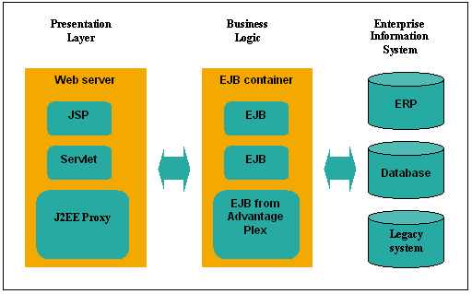
Learning 1 | My takeaways
→JEE
→CGI
→J2EE
→JSP

Slide 4
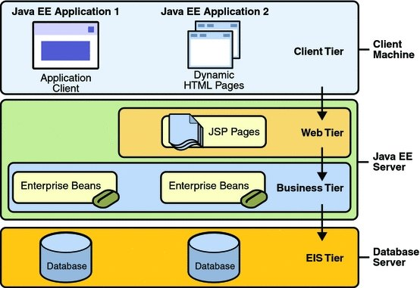
JEE:Java EE (now Jakarta EE), formerly Java 2 Platform, Enterprise Edition (J2EE), is a platform for building enterprise-level applications, providing a set of APIs, protocols, and services for distributed, scalable, and transactional systems.
→ It should have
1)Presentation layer
2)Business Logic
3)Data Access
CGI:The Common Gateway Interface (CGI) is a standard that facilitates communication between web servers and external databases or information sources. It acts as middleware, allowing web servers to interact with applications that process data and send back responses.
J2EE:
J2EE (Java 2 Platform, Enterprise Edition), now known as Jakarta EE, is a set of specifications and APIs that extend the Java SE platform for building enterprise-level, multi-tiered applications, including web services and distributed computing.
JSP:
JSP (JavaServer Pages) is a technology that allows developers to create dynamic web content using Java, offering a more flexible and readable way to embed Java logic within HTML pages, extending the functionality of Servlets.
Q

Slide 5
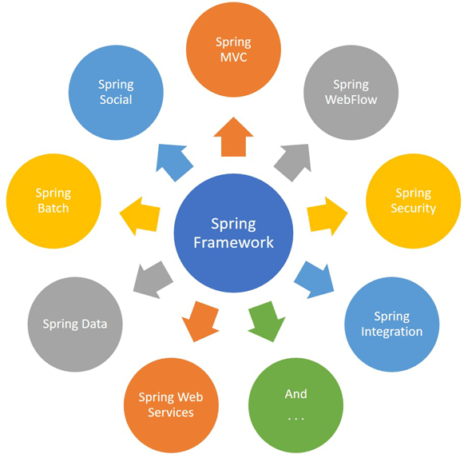
Learning 2| My Takeaways
→ JSP Scripting Elements
→Comments
→ Implicit Variables
→Spring Framework

Slide 6
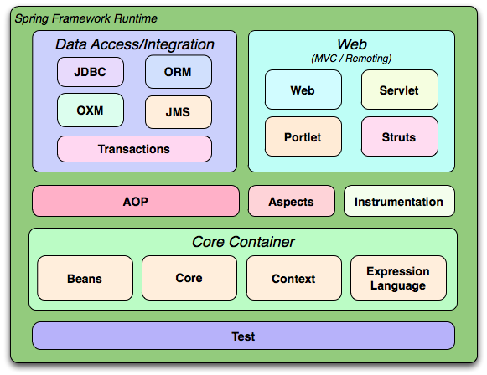
JSP Scripting Elements:
Java Server Page (JSP) is a technology for controlling the content or appearance of Web pages through the use of servlets. Small programs that are specified in the Web page and run on the Web server to modify the Web page before it is sent to the user who requested it.
There are total three Scripting Element in JSP
1)Scriptlet_tag
2)Expression tag
3)Declaration tag
Comments:There are three types of comments permitted in a JSP page
→HTML comments
→JSP page Comments
→Java Technology comments
Implicit Variables:In Java, "implicit variables" generally refer to variables that are not explicitly declared by the programmer but are implicitly provided or inferred by the language Framework ,such as the this keyword or implicit type conversions.
Spring Framework:
The Spring Framework is a comprehensive,
open-source Java platform and framework that simplifies
enterprise Java application development by providing
infrastructure support for various functionalities like dependency
injection, aspect-oriented programming, and web application
development

Slide 7
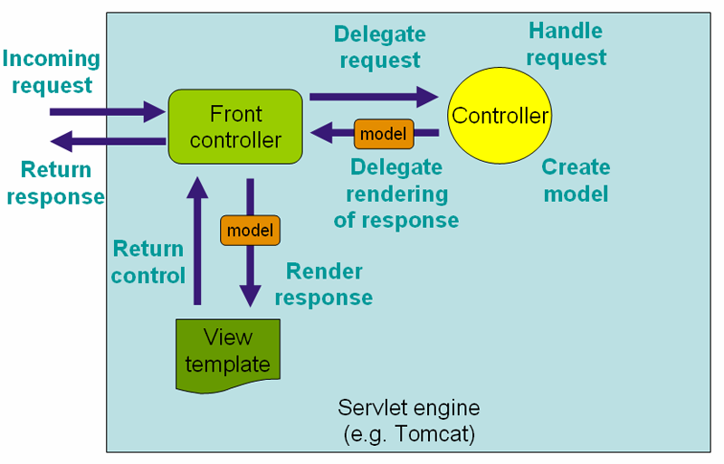
Learning 3| My takeaways
→Spring MVC
→Spring MVC Architecture
→ Architecture of IOC
→DispacherServlet

Slide 8
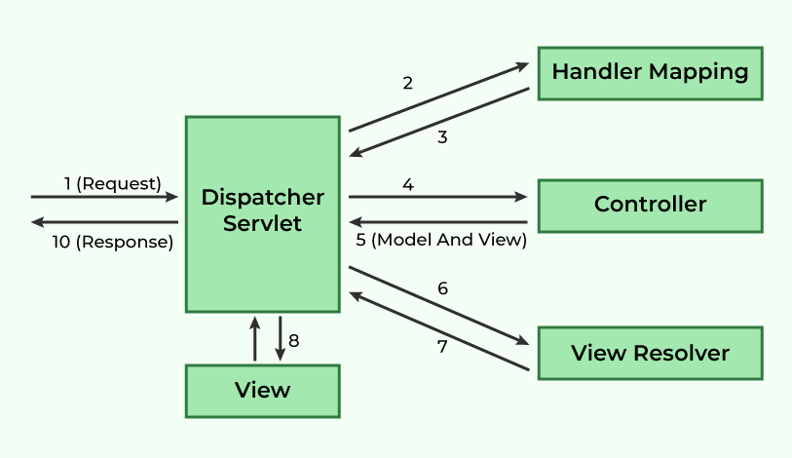
Spring MVC:
Spring MVC is a Java-based framework for building web applications that follows the Model-View-Controller (MVC) design pattern, facilitating the separation of application logic, data, and presentation. It's a core part of the Spring Framework, used for developing web applications with a focus on flexibility and loose coupling.
MVC Architecture:
Spring MVC implements the MVC pattern, which divides an application into three interconnected parts:
Model: Represents the data and business logic of the application.
View:Responsible for displaying the data to the user (e.g., HTML, JSON).
Controller: Handles user requests, interacts with the model, and selects the appropriate view.
DispatcherServlet:
The central component of Spring MVC that receives all incoming HTTP requests and dispatches them to the appropriate handler (controller).
Handler Mapping:Maps incoming requests to specific controller
methods based on URL patterns or other criteria.
Controller: Processes the request, interacts with the model, and
returns a Model and View Object.
View Resolver:
Resolves the view name returned by the controller and renders
the view
Model:Stores the data that will be displayed in the view.
View: Renders the data to the user.

Slide 9
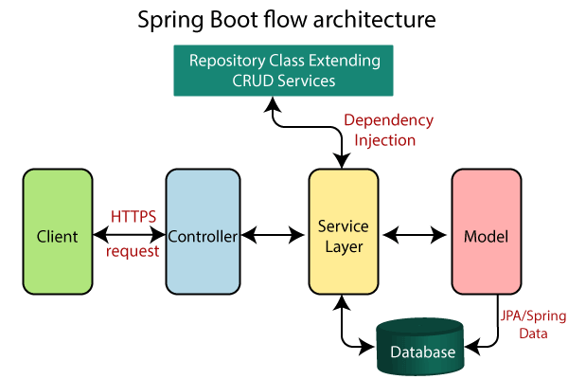
Learning 4 | takeaways
→Spring Boot
→Creation of Spring Boot Project
→Annotations
→ Spring Boot Architecture

Slide 10
Spring Boot:
Spring Boot is a Java-based framework used to simplify the development of Spring-based applications, especially web applications and microservices, by providing a streamlined and opinionated approach to configuration and deployment.
Key Features:
→Auto-configuration
→Embedded Servers:
→Opinionated Approach
→Microservices
Creation of Spring Boot Project:
We can create a spring boot project in two ways ---- 1)Spring Initializer 2)Spring STS IDE
Annotations :
In Java, annotations are a form of syntactic metadata that can be added to source code, providing information about classes, methods, variables, parameters, and packages.
@spring boot application,@Controller,@RestController,@Autowired@Service,@Repository,@GetMapping
@PostMapping,@RequestParam
Spring boot Architecture: Spring Boot consists of the following four layers:
Presentation Layer: Handles HTTP requests, authentication, and JSON conversion.
Business Layer: Contains business logic, validation, and authorization.
Persistence Layer: Manages database interactions using ORM frameworks like Spring Data JPA.
Database Layer: Stores application data using relational (MySQL, PostgreSQL) and NoSQL databases (MongoDB, DynamoDB).

Slide 11
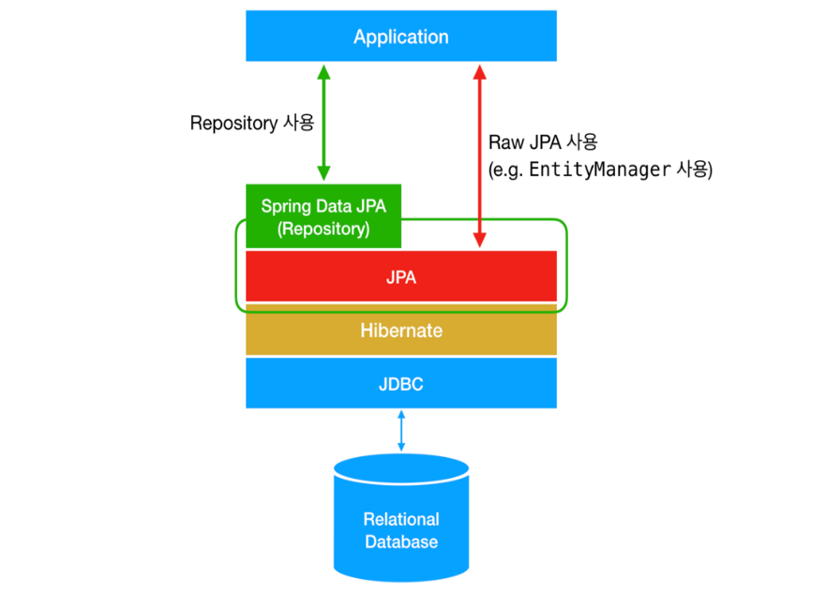
Learning 5 | takeaways
→Spring MVC & Rest
→Spring Data JPA
→ORM
→JPA

Slide 12
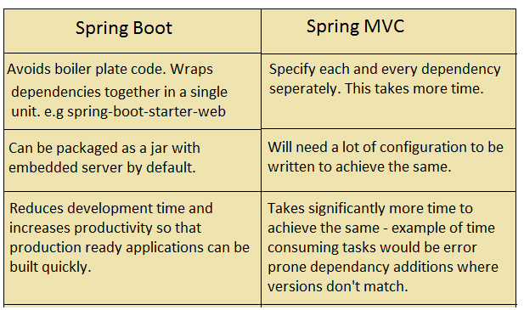
Spring MVC & Rest:
Spring Data JPA: Spring Data JPA, part of the larger Spring Data family, makes it easy to easily implement JPA-based (Java Persistence API) repositories. It makes it easier to build Spring-powered applications that use data access technologies.
ORM:ORM, or Object-Relational Mapping, is a programming technique that simplifies interaction between object-oriented programming languages and relational databases by mapping objects to database tables, allowing developers to work with data as objects rather than writing SQL queries directly.
JPA: JPA or Java Persistence API, is a standard specification for managing relational data in Java applications, providing a way to map Java objects to database tables, simplifying database operations and promoting portability.

Slide 13
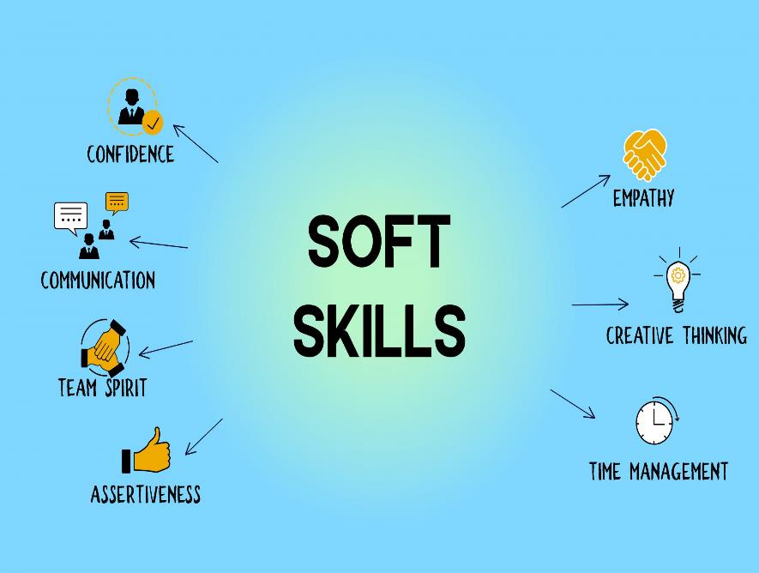
Learning 6 | takeaways
→Etiquettes
→Dialects
→Diction

Slide 14
Soft Skills:
Soft skills are non-technical skills that describe how you work and interact with others. They are also known as people skills.
→Communication: Being able to express yourself clearly, listen well, and have a productive conversation
→Teamwork: Working well with others to achieve goals
→Problem-solving: Using your skills to solve issues →Adaptability:Adjusting to changes at work
→Time management: Using your time efficiently
→Leadership:Inspiring others to lead with confidence and compassion.
→Creativity: Using your imagination to solve problems and promote teamwork
Dialects:
A dialect is a regional or social variety of a language, distinguished by vocabulary, pronunciation, and grammar, often spoken by a specific group. For example, "y'all" is a dialectal expression used in the Southern United States, while "trousers" is a British English word for "pants" in American English.
Diction:
Diction refers to a writer's or speaker's deliberate choice of words, impacting tone, style, and the overall meaning conveyed in writing or speech.
Types of Diction:
Formal: Characterized by precise, elevated language, often used in academic or professional contexts.
Informal: Uses everyday language, contractions, and slang, often found in casual conversations or personal writing.
Abstract: Refers to words that describe intangible concepts, ideas, or emotions that cannot be perceived through the senses.

Slide 15
Thank You

